Slide 1
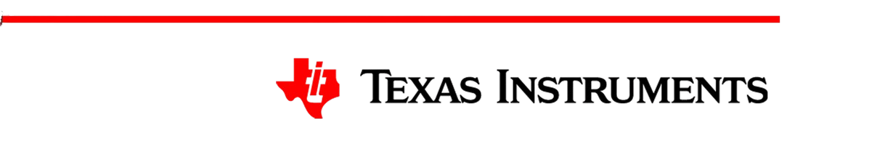


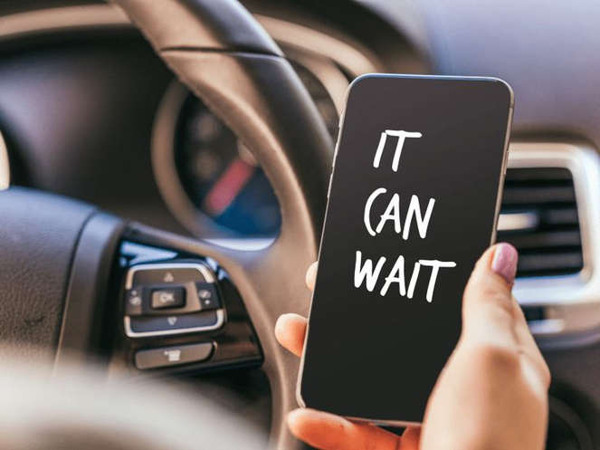
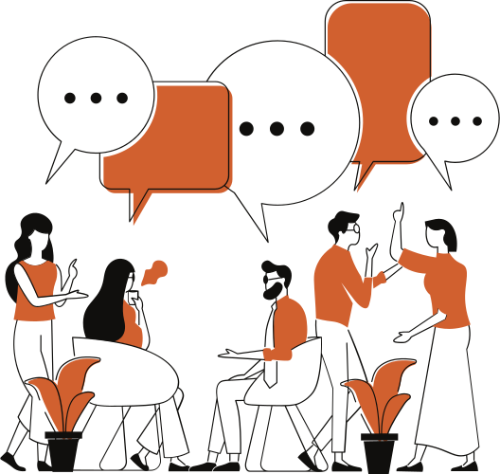
DisTracker
GROUP 19 :
Manvitha
Akhila
Nitisha
Anshu
Shruthi

Slide 2



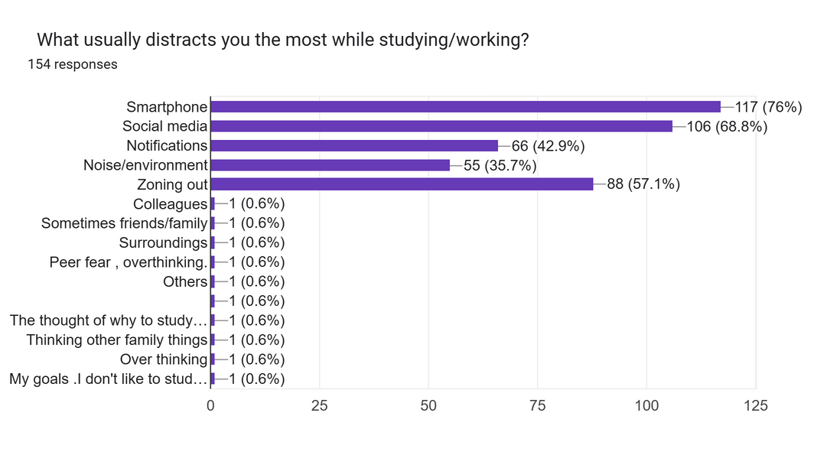
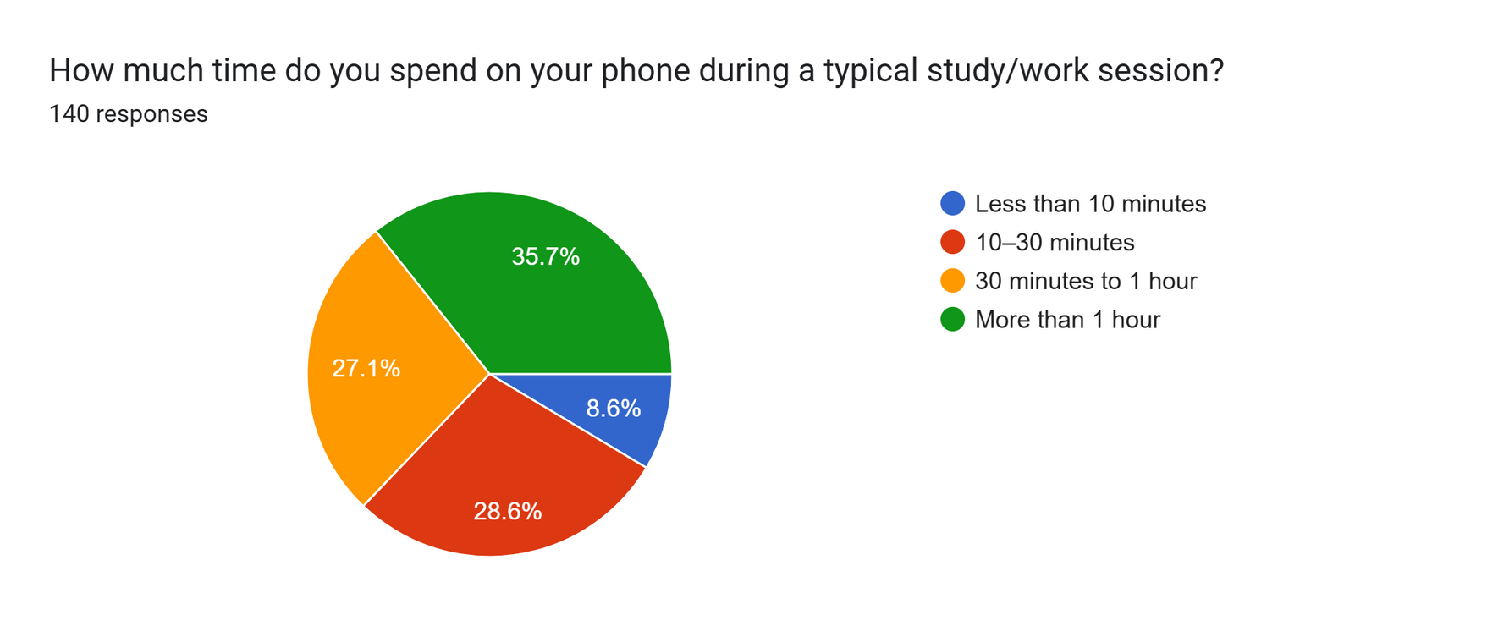
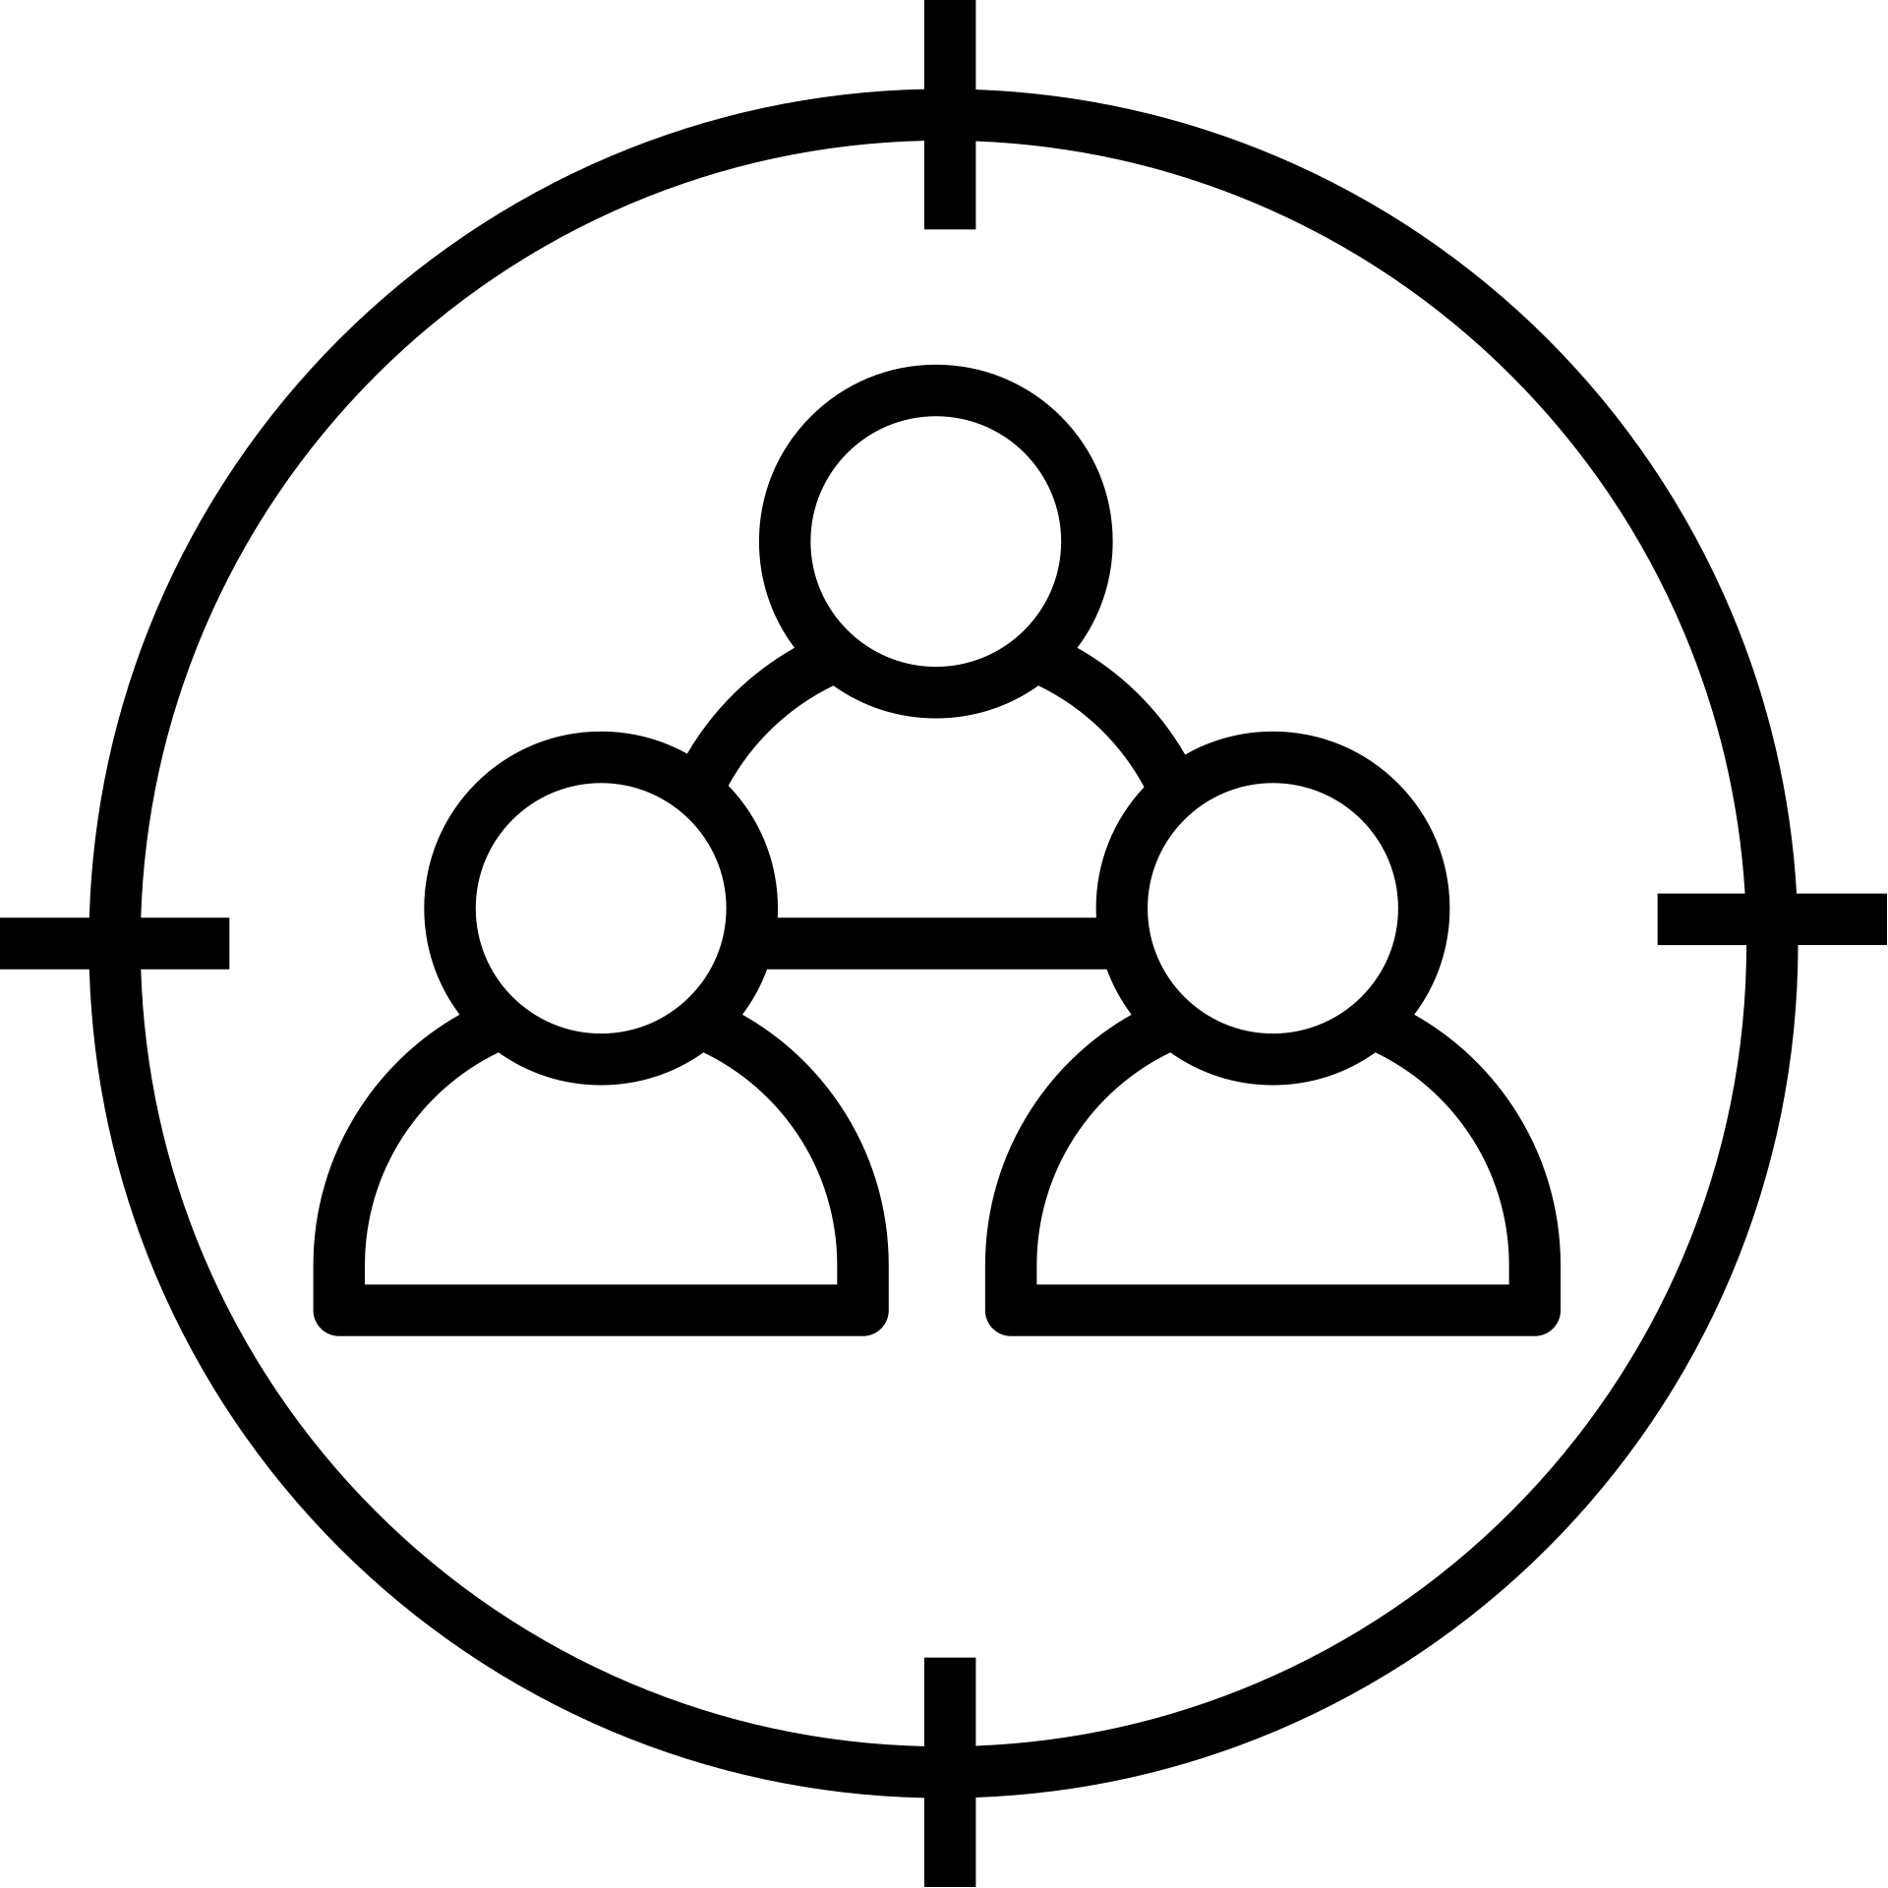
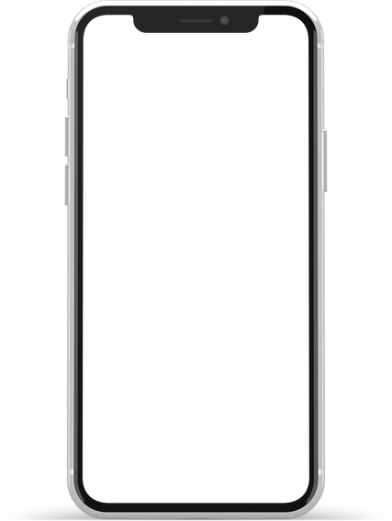


EMPHATIZE
Shared GOOGLE FORM survey with 150+ responses
What usually distracts you the most while studying while Studying/Working ?
What is the time spent on phone during a typical study/work session
UNDERSTAND THE REAL NEED !!!
WHO ARE YOUR USERS? (TARGET AUDIENCE)
Students, especially high school and college students, who struggle to maintain focus during study/work sessions.
WHAT CAUSING DISTRACTION?
SMART PHONES (SOCIAL MEDIA, NOTIFICATIONS)ARE THE MAJOR CAUSE DISTRACTIONS, MAKING IT HARD TO MAINTAIN FOCUS.
USER PAIN POINTS
Frequent distractions, Difficulty staying focused for long hours, decreased productivity, stress, and poor academic/work performance.

Slide 3



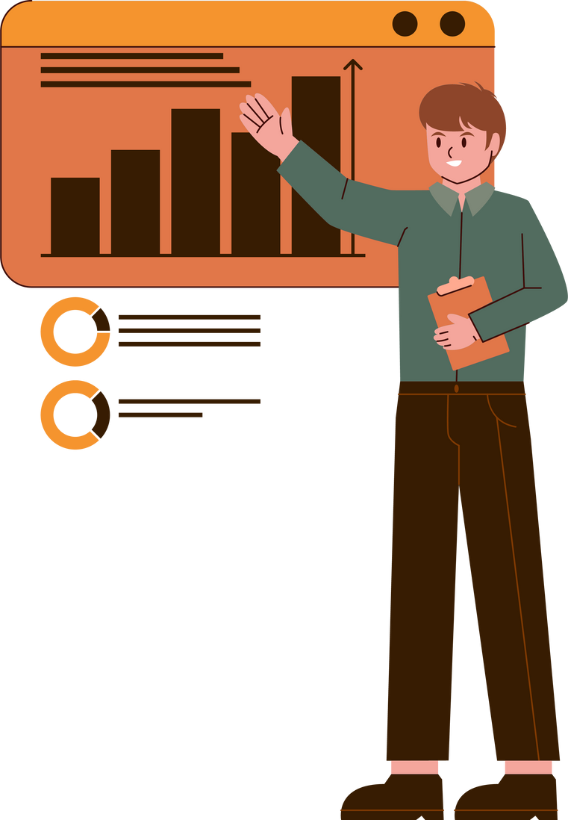
DEFINE
EMPATHY TAKEAWAY
Students’ attention naturally peaks in adolescence but is frequently broken by digital distractions. The significant delay in refocusing after interruptions underscores the need for a real-time, wearable nudge to help maintain and regain focus.
REFINED PROBLEM STATEMENT
How do we help students fight smartphone and social media distractions without disrupting their environment?
The solution is DISTRACTION MONITORING WRISTBAND .
FIND THE WHY BEFORE THE HOW !!!
USER NEEDS
Need a non-intrusive way to monitor focus and alert them during distractions.
Need a real-time, subtle feedback system without disturbing others.
Need a personalized focus tracker that adapts to their working style and environment.
INSIGHTS
Users often fail to realize when they get distracted, especially during mentally exhausting sessions.
Users prefer discreet feedback mechanisms over public or disruptive alerts.
Continuous distractions affect not just productivity but also increase stress and mental fatigue over time.

Slide 4
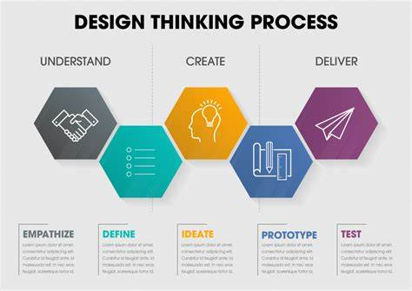

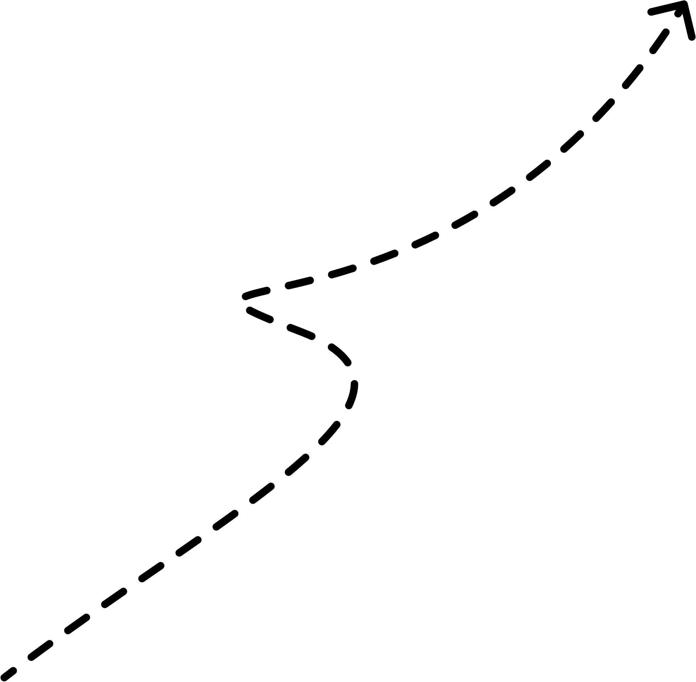
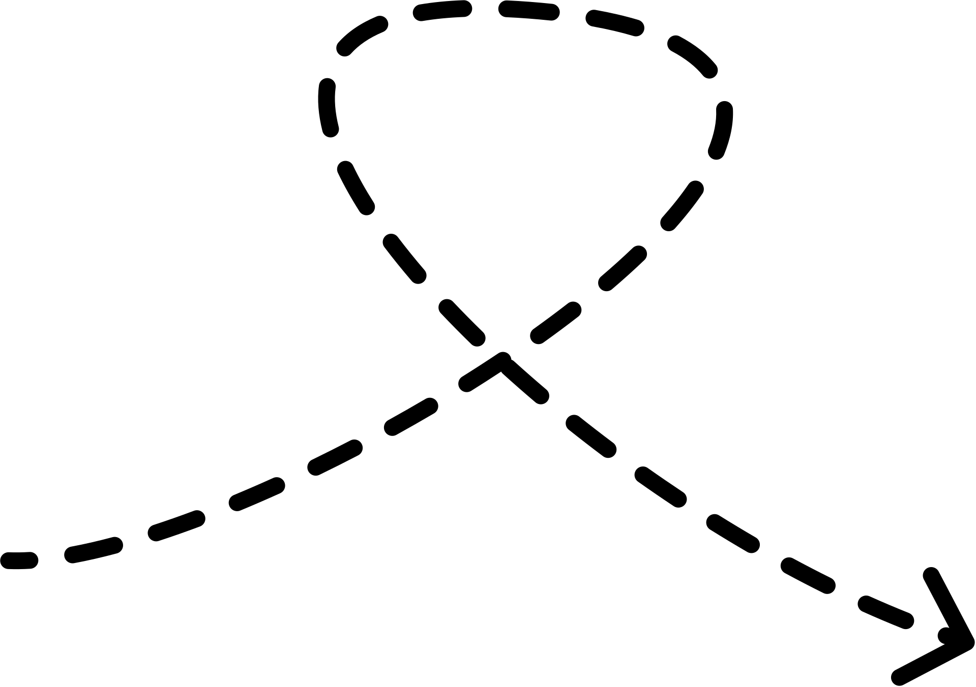
IDEATE
How to know when a person is distracted
How to let them know that they are distracted
EDA: ELECTRODERMAL ACTIVITY
Measures changes in the skin’s electrical conductance, which varies with sweat gland activity
PPG: PHOTOPLETHYSMOGRAPHY
A non-invasive optical technique that measures blood volume changes in the microvascular bed of tissue, typically used to monitor heart rate and related metrics.
3-axis Accelerometer + Gyroscope
Combining both allows for motion tracking, gesture recognition, and orientation detection
Screen Monitoring(only in Android)
Can create an app that uses ML to monitor the screen and differentiate if an app is the cause of distraction
How to process the data
Vibration feedback
TinyML models are used to enable real-time, low-power, on-device processing of sensor data for immediate distraction detection without relying on external devices.
(using 1D CNN)
Led Feedback

Slide 5

2
Getting distracted
1
Studying with focus
LIKELY FOCUSED
LIKELY DISTRACTED
Accelerometer: minimal movement
EDA: stable, mid-high
PPG: steady
HR: low HRV
Accelerometer: sudden wrist motion
EDA: sharp rise (attention/stress)
PPG: HR jump
REALISTIC DETECTION SCENARIOS
3
Bored/Zoning Out
4
Anxious or stressed
POSSIBLY DISENGAGED
MENTALLY DISTRACTED/STRESSED
Accelerometer: very low motion
EDA: very low
PPG: low HR
Accelerometer: tapping/fidgeting
EDA: high
PPG: irregular HR

Slide 6

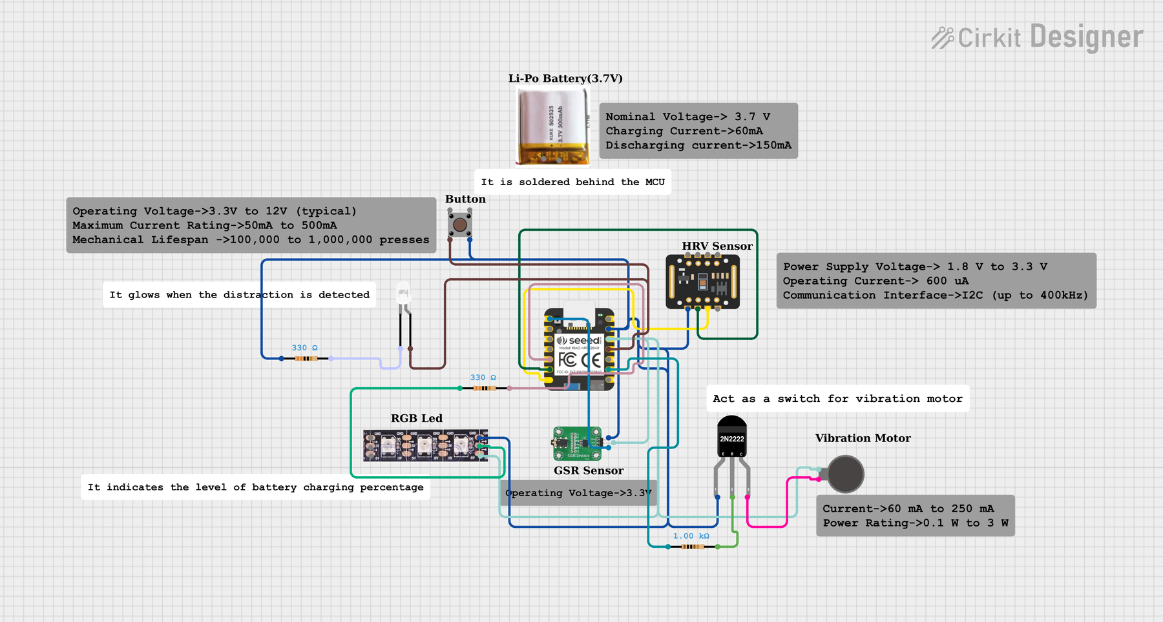
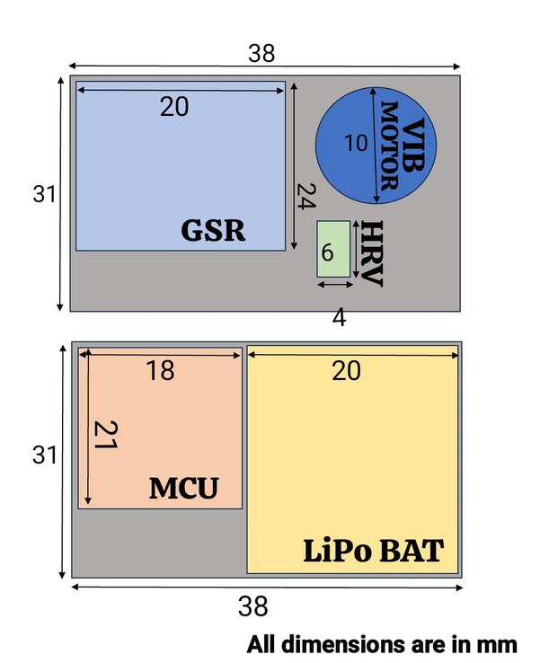
PROTOTYPE - HARDWARE
“This prototype integrates health sensing (GSR, HRV), feedback (vibration motor, Led), and processing (MCU, LiPo) in a compact, wearable form factor. Each component is modularly placed to optimize skin contact, ventilation, and accessibility.”

Slide 7
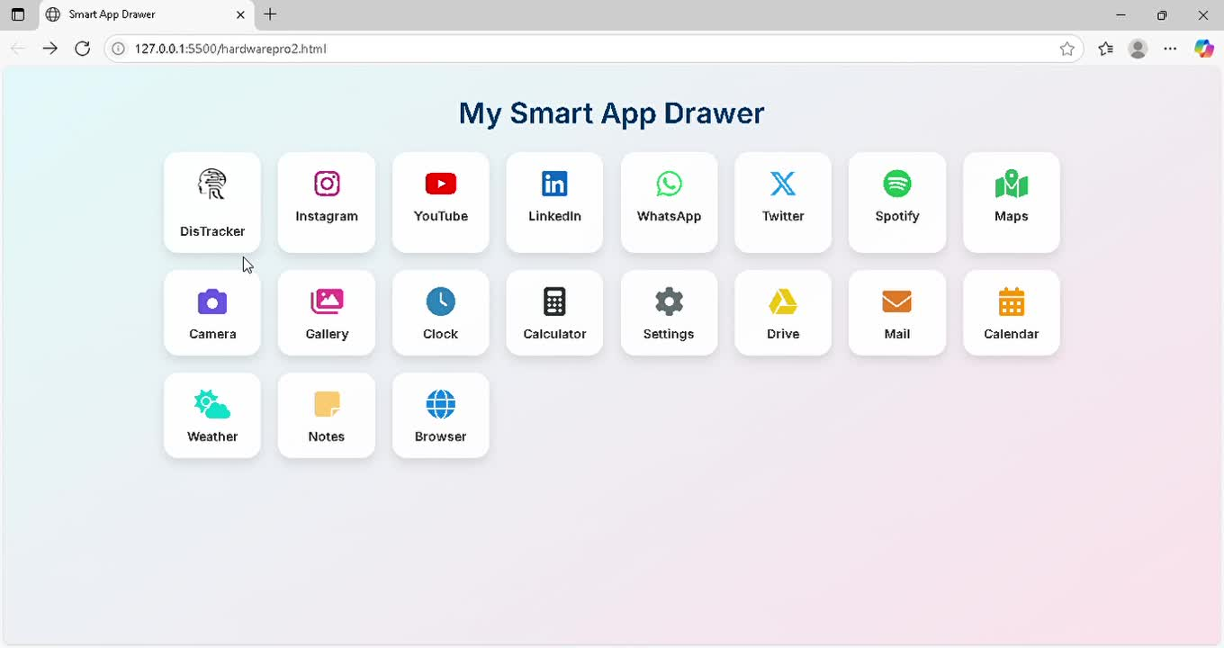

PROTOTYPE - SOFTWARE
Sensors
MCU+BLE
BLE
Mobile App
COLLECT MOBILE USAGE FROM MOBILE PHONE
IF ENTERTAINMENT APP>10 MIN PER HR---> VIBRATION FEEDBACK
COLLECT DATA FROM SENSORS
ANALYSE TO SHOW VARIOUS GRAPH AND INFO IN THE APPLICATION

Slide 8
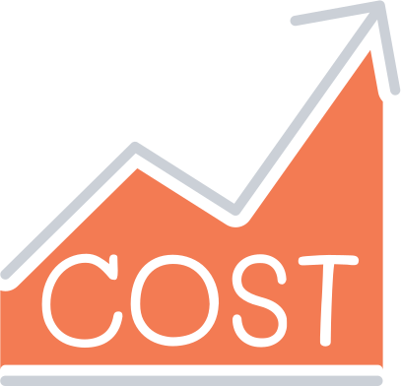
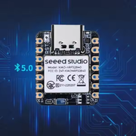
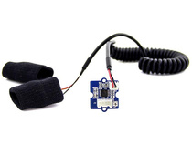
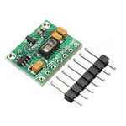
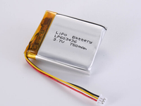
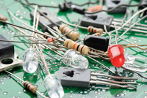

Estimated Cost Analysis
Images | Components | Description | Price
 | Seeed nRF52840 Sense | BLE enabled microcontroller, compatible for tinyML models | 1400-1900
 | Ohmite Grove GSR | Galvanic Skin response sensor, measures conductivity of skin | 400-700
 | HRV Sensor | Measures variability in heart rate and pulse waveform, outputs digital data | 100-300
 | Lipo Battery | Rechargeable 300mAh | 150-400
 | Passive Components | Resistors,wires, LEDs, vibratory motor | 150-300
 | Net Gross |  | 2200-3900

Slide 9

test
SOLUTION
If we monitor screen continuously then it consumes more power
HRV and EDA signals exhibit high inter-person variability
Cost of the device its around 3k
HRV and EDA sensors are highly temperature variant, Humid classrooms causes false alarms.
Debouncing in manual push button
We first filter apps using user stats and
then monitor screen incase of apps which
serve dual purposes
2. We collect baseline data from each individual at
the start and use this personalized data and
continuous data collected to train our tiny ML
3. Instead of making use of all separate
components like GSR and HRV sensors separately
if we have all of them in same chip we could
reduce cost of packaging and area too
4. We introduce a temperature compensation
sensor (150rs) it takes temperature as input and
we give it to ML models to analyze for patterns
5. Implementing simple schmitt trigger circuit to
set a certain range of thresholds
models
PROBLEMS

Slide 10

TEST
EDA
HRV
ONBOARD 3 AXIS ACCELEROMETER
MCU
Dry vs Wet skin
Meditation
Stress test
Integration with mcu - Connect with analog input pin in mcu and a basic test code
Exercise
Deep breathing
Integration with mcu - Install SparkFun MAX3010x library (works for both MAX30102/03)
Run Example code
Blink Test (Arduino IDE)
BLE Test
I2C Test for Onboard Sensors (IMU)
MPU6886 IMU Sensor Test
UART/Serial
Storage/Upload
Still Test
Tilting Test
Tap or Shake Test
MOTOR
TINYML MODEL
ENVIRONMENTAL ROBUSTNESS
LINK FOR TESTING CODES
Testing the Vibratory Motor Separately
Testing Sensor-to-Motor Integration via code
Input feature validation
Distraction classification test
False positive rate
https://docs.google.com/document/d/16yhCMC3rUK1BajkGnp0COPW4I09iADXiPK6Dr1_ApEE/edit?usp=sharing
Temperature variation
Sweat simulation

Slide 11

REFERENCES
https://www.thencri.org/glossary/eloreta/
https://www.ti.com/lit/ab/sbaa556/sbaa556.pdf?ts=1750388805977&ref_url=https%253A%252F%252Fwww.google.com%252F
https://pdfs.semanticscholar.org/b5f7/095bae46986a142c93f2890e6ce33624522c.pdf

Slide 12
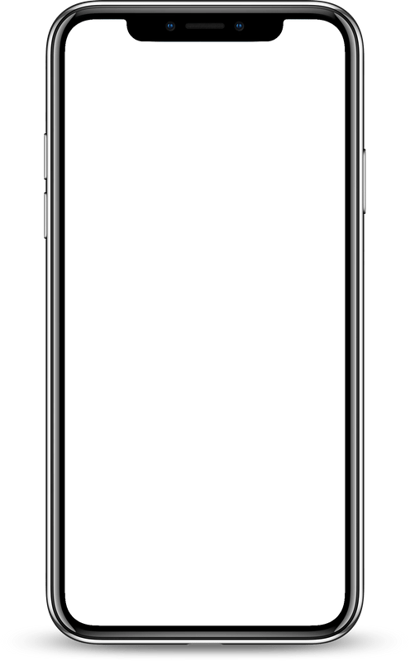
Thank You

